Slide 1
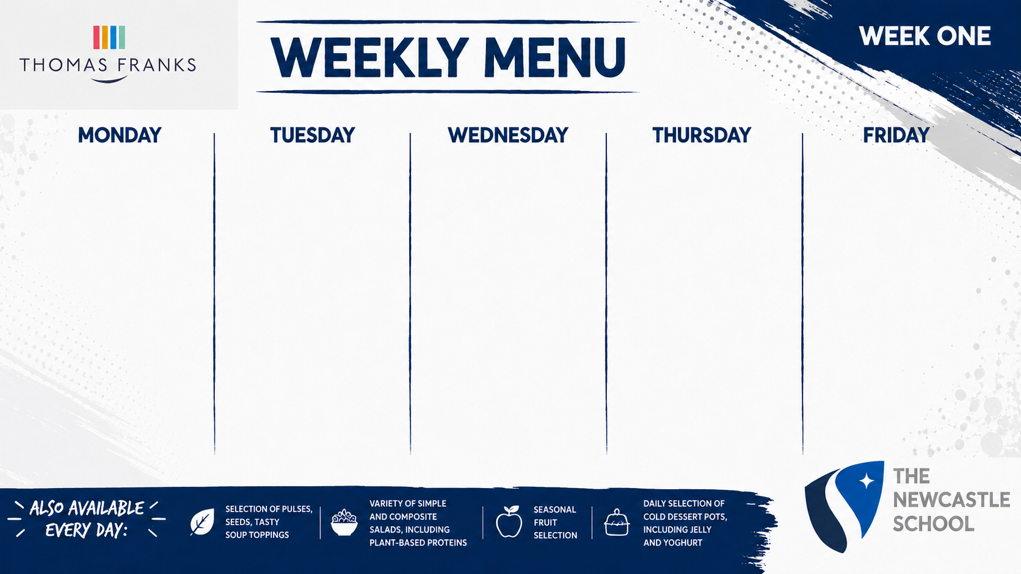
LUNCH MAIN CHOICE
Mexican Beef Chilli Served with Tomato Salsa, Guacamole
VEGETARIAN CHOICE
Vegetable Enchiladas
SIDES
Boiled Rice, Mixed Vegetables, Tortilla Chips
JACKET OR PASTA
Baked Beans, Tomato Sauce
HOT & COLD DESSERT
Chocolate Chip Sponge and Custard
LUNCH MAIN CHOICE
Sticky Teriyaki Chicken Served with Noodles
VEGETARIAN CHOICE
Vegetable Chow Mein
SIDES
Broccoli, Sweetcorn, Prawn Crackers
JACKET OR PASTA
Baked Beans, Tomato Sauce
HOT & COLD DESSERT
Jam & Coconut Sponge
LUNCH MAIN CHOICE
Chicken Tikka Masala Curry Served with Naan Bread
VEGETARIAN CHOICE
Butternut Squash, Chickpea and Lentil Curry
SIDES
Turmeric Rice, Green Beans
JACKET OR PASTA
Baked Beans, Tomato Sauce
HOT & COLD DESSERT
Sticky Toffee Pudding and Custard
LUNCH MAIN CHOICE
Roast Chicken, Roast Pork, Yorkshire Pudding and Gravy
VEGETARIAN CHOICE
Root Vegetable Strudel
SIDES
Roast Potatoes, Roast Carrots, Savoy Cabbage
JACKET OR PASTA
Baked Beans, Tomato Sauce
HOT & COLD DESSERT
Creamy Rice Pudding Served with Jam Sauce
LUNCH MAIN CHOICE
Battered Cod, Fish Fingers
VEGETARIAN CHOICE
Macaroni Cheese
SIDES
Fries, Mushy Peas, Baked Beans
JACKET OR PASTA
Baked Beans, Tomato Sauce
HOT & COLD DESSERT
Crunchy Oat Flapjack

Slide 2

LUNCH MAIN CHOICE
Pizza of the Day
VEGETARIAN CHOICE
Cheese Pizza
SIDES
Cajun Potato Wedges Sweetcorn
JACKET OR PASTA
Baked Beans, Tomato Sauce
HOT & COLD DESSERT
Syrup Sponge Served with Custard
LUNCH MAIN CHOICE
Pork Sausage Served with Gravy
VEGETARIAN CHOICE
Vegan Sausage Served with Gravy
SIDES
Mash Potato, Garden Peas, Carrots
JACKET OR PASTA
Baked Beans, Tomato Sauce
HOT & COLD DESSERT
Chocolate Chip Cookie
LUNCH MAIN CHOICE
Pasta Bolognaise
VEGETARIAN CHOICE
Halluomi & Roast Vegetable Wrap
SIDES
Garlic Bread, Green Beans, Salad
JACKET OR PASTA
Baked Beans, Tomato Sauce
HOT & COLD DESSERT
Lemon Drizzle Cake
LUNCH MAIN CHOICE
Roast Gammon, Roast Chicken, Yorkshire Pudding and Gravy
VEGETARIAN CHOICE
Butterbean and Vegetable Hotpot
SIDES
Roast Potatoes, Roast Parsnips, Savoy Cabbage
JACKET OR PASTA
Baked Beans, Tomato Sauce
HOT & COLD DESSERT
Toffee Apple Crumble Served with Custard
LUNCH MAIN CHOICE
Southern Fried Chicken
Served in a Floured Bap
VEGETARIAN CHOICE
Vegetable Burger
SIDES
Fries, Baked Beans
JACKET OR PASTA
Baked Beans, Tomato Sauce
HOT & COLD DESSERT
Chocolate Brownie

Slide 3

LUNCH MAIN CHOICE
Beef Lasagne
VEGETARIAN CHOICE
Roast Vegetable and Lentil Pasta Bake
SIDES
Garlic Bread, Sweetcorn, Salad
JACKET OR PASTA
Baked Beans, Tomato Sauce
HOT & COLD DESSERT
Chocolate Marble Sponge Served with Custard
LUNCH MAIN CHOICE
Mince Beef and Dumplings
VEGETARIAN CHOICE
Butternut Squash, Caramelised Onion and Feta Cheese Tart
SIDES
Mash Potato, White Cabbage, Peas
JACKET OR PASTA
Baked Beans, Tomato Sauce
HOT & COLD DESSERT
Oaty Biscuit
LUNCH MAIN CHOICE
Chinese Chicken Curry
VEGETARIAN CHOICE
Sweet Potato, Spinach and Red Lentil Dahl
SIDES
Boiled Rice, Green Beans, Prawn Crackers
JACKET OR PASTA
Baked Beans, Tomato Sauce
HOT & COLD DESSERT
Chocolate and Blueberry Muffin
LUNCH MAIN CHOICE
Roast Beef or Chicken, Yorkshire Pudding and Gravy
VEGETARIAN CHOICE
Stuffed Peppers with Chickpea and Vegetable Rice
SIDES
Roast Potatoes, Cauliflower Cheese, Savoy Cabbage
JACKET OR PASTA
Baked Beans, Tomato Sauce
HOT & COLD DESSERT
Apple Crumble Served with Custard
LUNCH MAIN CHOICE
Hotdog In a Bun
VEGETARIAN CHOICE
Vegan Sausage In a Bun
SIDES
Fries, Baked Beans
JACKET OR PASTA
Baked Beans, Tomato Sauce
HOT & COLD DESSERT
Crunchy Chocolate Chip Flapjack

