Slide 1
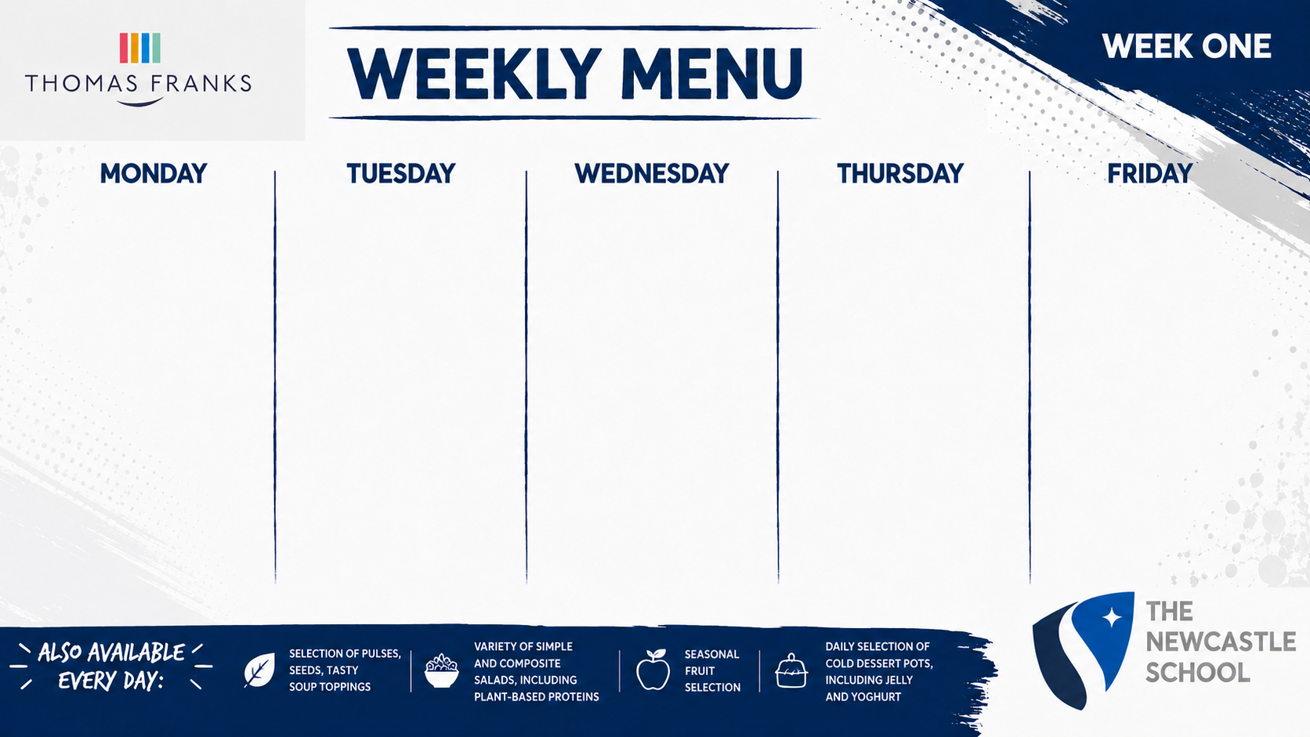
LUNCH MAIN CHOICE
Mexican Chilli Beef, Salsa, Guacamole, Tortilla Chips
VEGETARIAN CHOICE
Vegetable Enchilada Bake
SIDES
Mexican Rice, Sweetcorn and Roasted Peppers
JACKET OR PASTA
Baked Beans, Tomato Sauce, Chefs Filling of the Day
HOT & COLD DESSERT
Chocolate Chip Sponge and Custard
LUNCH MAIN CHOICE
Sticky Teriyaki Chicken, Soy Fried Noodles, Stir Fried Vegetables
VEGETARIAN CHOICE
Sweet and Sour Tofu, Soy Fried Noodles, Stir Fried Vegetables
SIDES
Stir Fried Vegetables, Prawn Crackers
JACKET OR PASTA
Baked Beans, Tomato Sauce, Chefs Filling of the Day
HOT & COLD DESSERT
Coconut and Jam Sponge
LUNCH MAIN CHOICE
Butter Chicken, Naan Bread, Mango Salad
VEGETARIAN CHOICE
Vegetable and Chickpea Korma, Naan Bread, Mango Salad
SIDES
Pilau Rice, Bombay Potatoes, Cucumber Salad
JACKET OR PASTA
Baked Beans, Tomato Sauce, Chefs Filling of the Day
HOT & COLD DESSERT
Golden Syrup Sponge Pudding
LUNCH MAIN CHOICE
Roast Chicken or Roast Pork, Yorkshire Pudding, Gravy
VEGETARIAN CHOICE
Potato, Cheese and Leek Pie,
Yorkshire Pudding, Gravy
SIDES
Roast Potatoes, Honey Roast Carrots, Seasonal Greens
JACKET OR PASTA
Baked Beans, Tomato Sauce, Chefs Filling of the Day
HOT & COLD DESSERT
Toffee Apple Crumble and Custard
LUNCH MAIN CHOICE
Southern Fried Chicken or Battered or Steamed Fish of The Day
VEGETARIAN CHOICE
Tomato and Mozzarella Pasta Bake
SIDES
Fries, Mushy Peas, Baked Beans
JACKET OR PASTA
Baked Beans, Tomato Sauce, Chefs Filling of the Day
HOT & COLD DESSERT
‘Old School’ Sponge Cake

Slide 2

LUNCH MAIN CHOICE
Chicken Shawarma Flatbread, Garlic Sauce, Pickled Cabbage
VEGETARIAN CHOICE
Halloumi and Roast Vegetable Wrap
SIDES
Sweet Potato Wedges, Mediterranean Salad
JACKET OR PASTA
Baked Beans, Tomato Sauce, Chefs Filling of the Day
HOT & COLD DESSERT
Biscoff Sponge Cake
LUNCH MAIN CHOICE
Barbacoa Pulled Beef, Wedges, Salsa, Sour Cream
VEGETARIAN CHOICE
Smoky Mixed Bean Chilli, Salsa, Sour Cream
SIDES
Wedges, Mexican Rice, Sweetcorn, Slaw
JACKET OR PASTA
Baked Beans, Tomato Sauce, Chefs Filling of the Day
HOT & COLD DESSERT
Chocolate Brownie
LUNCH MAIN CHOICE
Chicken Tikka Masala, Chutneys, Poppadom
VEGETARIAN CHOICE
Butternut Squash and Lentil Madras, Chutneys, Poppadom
SIDES
Braised Rice, Steamed Mixed Vegetables
JACKET OR PASTA
Baked Beans, Tomato Sauce, Chefs Filling of the Day
HOT & COLD DESSERT
Lemon Drizzle Cake
LUNCH MAIN CHOICE
Honey Roast Gammon or Chicken, Yorkshire Pudding, Gravy
VEGETARIAN CHOICE
Tomato and Feta Tart, Balsamic Glaze
SIDES
Roast Potatoes, Caramelised Root Vegetables, Wilted Greens
JACKET OR PASTA
Baked Beans, Tomato Sauce, Chefs Filling of the Day
HOT & COLD DESSERT
Apple and Blackberry Crumble
LUNCH MAIN CHOICE
Korean Fried Chicken or Battered or Steamed Fish of The Day
VEGETARIAN CHOICE
Dubu Jorim Sticky Braised Tofu
SIDES
Fries, Asian Slaw, Baked Beans
JACKET OR PASTA
Baked Beans, Tomato Sauce, Chefs Filling of the Day
HOT & COLD DESSERT
Cookies

Slide 3

LUNCH MAIN CHOICE
Chicken and Chorizo Paella, Roasted Peppers, Tomato
VEGETARIAN CHOICE
Potato and Onion Spanish Tortilla
SIDES
Paprika Potatoes, Green Beans
JACKET OR PASTA
Baked Beans, Tomato Sauce, Chefs Filling of the Day
HOT & COLD DESSERT
Apple and Cinnamon Sponge and Custard
LUNCH MAIN CHOICE
Peri-Peri Chicken, Garlic and Lemon Dressing
VEGETARIAN CHOICE
Peri-Peri Sweet Potato and Black Bean Bake
SIDES
Spicy Rice, Corn Cob, Chefs Salads
JACKET OR PASTA
Baked Beans, Tomato Sauce, Chefs Filling of the Day
HOT & COLD DESSERT
White Chocolate and Raspberry Sponge
LUNCH MAIN CHOICE
Traditional Beef Lasagne, Garlic Bread
VEGETARIAN CHOICE
Roast Vegetable and Lentil Pasta Bake
SIDES
Roast Courgettes, Garlic Bread, Mixed Leaves
JACKET OR PASTA
Baked Beans, Tomato Sauce, Chefs Filling of the Day
HOT & COLD DESSERT
Orange Drizzle Cake
LUNCH MAIN CHOICE
Roast Beef or Chicken, Yorkshire Pudding and Gravy
VEGETARIAN CHOICE
Mushroom, Spinach and Cheese Wellington
SIDES
Roast Potatoes, Cauliflower Cheese, Savoy Cabbage
JACKET OR PASTA
Baked Beans, Tomato Sauce, Chefs Filling of the Day
HOT & COLD DESSERT
Golden Syrup Sponge Pudding
LUNCH MAIN CHOICE
Pepperoni Pizza or Battered or Steamed Fish of The Day
VEGETARIAN CHOICE
Margherita Pizza
SIDES
Chips, Baked Beans, Mushy Peas
JACKET OR PASTA
Baked Beans, Tomato Sauce, Chefs Filling of the Day
HOT & COLD DESSERT
Flapjack

